Slide 1


Beamspace Channel Estimation for Millimeter-Wave Massive MIMO Systems with Lens Antenna Array
Linglong Dai¹, Xinyu Gao¹, Shuangfeng Han², Chih-Lin I², and Xiaodong Wang³
¹Department of Electronic Engineering, Tsinghua University
²Green Communication Research Center, China Mobile Research Institute
³Department of Electrical Engineering, Columbia University
2016-07-29
Notes:
Good morning everyone! I’m Linglong Dai from Tsinghua University. The title of my presentation is beamspace channel estimation for millimeter-wave massive MIMO systems with lens antenna array. As we know, the high energy consumption caused by the huge number of RF chains is a bottleneck problem for mmWave massive MIMO systems, and the beamspace MIMO with lens antenna array can be considered as a promising solution. However, to achieve the capacity-approaching performance, we need to know the information of the beamspace channel, which is the target of this paper.

Slide 2
Contents
1
Technical Background
2
Proposed Solution
3
Performance Analysis
4
Simulation Results
5
Conclusions
Notes:
This presentation includes 5 parts. At the beginning, let’s look at the technical background and motivation of this work.

Slide 3
Advantages of mmWave massive MIMO
Advantages
  High frequency (30-300 GHz)
  Larger bandwidth: 20MHz → 2GHz
  Short wavelength (1-10 mm)
  Enable large antenna array (massive MIMO): 1~8 → 256~1024
  Higher array and multiplexing gains to improve spectral efficiency
  Serious path-loss
  Avoid multi-cell interference, more appropriate for small cell
mmWave
High frequency
Short wavelength
Serious path-loss
Spectrum expansion
Large antenna array
Small cell
1000x capacity increase!
Notes:
As we can see from the figure, there are three special properties of mmWave. The first one is the high frequency around and above 30GHz, where the spectrum is less crowded, so we can provide much larger bandwidth for communication, e.g., the bandwidth can be increased from 20MHz to 2GHz, 100 times larger. The second property is the short wavelength, which enables a large antenna array to be arranged in a small area. That means we can achieve higher array gain and multiplexing gain to significantly improve the spectral efficiency. The last property is the serious path-loss, which can efficiently avoid multi-cell interference, which is attractive for the dense deployment of small cells. In conclusion, mmWave massive MIMO is able to combine the roadmaps of 5G in an unified way to achieve 1000 times capacity increase in the future.

Slide 4

Challenges of mmWave massive MIMO
Challenges
  Traditional MIMO: one dedicated RF chain for one antenna
  Enormous number of RF chains due to large antenna array
  Unaffordable energy consumption (250 mW per RF chain at 60 GHz)
  MmWave massive MIMO BS with 256 antennas → 64 W (only RF)
  Micro-cell BS in 4G → several W (baseband + RF + transmit power)
How to reduce the number of required RF chains?
Notes:
However, realizing mmWave massive MIMO in practice is not a trivial task. One key challenge is that each antenna in MIMO systems usually requires one dedicated RF chain including high-speed ADC, power amplifier, etc. This results in unaffordable hardware cost and energy consumption in mmWave massive MIMO systems, as the number of antennas becomes huge and the energy consumption of RF chain in mmWave band is high. For example, at 60 GHz, one RF chain will consume 250 mW. If we consider a mmWave massive MIMO base station (BS) with 256 antennas, the RF chains will consume 64 Watts, which is much higher than the total power consumption of current 4G micro-cell BS. This problem is considered as “the death of 5G” by some experts. Therefore, it is urgent for us to find out an efficient solution to reduce the number of required RF chains.

Slide 5
Beamspace MIMO with lens antenna array
Basic idea [Brady’13]
  Concentrate the signals from different directions (beams) on different antennas by lens antenna array
  Transform conventional spatial channel into beamspace (spatial DFT)
  Limited scattering at mmWave→ beamspace channel is sparse
  Select dominant beams to reduce the dimension of MIMO system
  Negligible performance loss→ significantly reduced number of RF chains
Conventional MIMO
Beamspace MIMO
[Brady’13] J. Brady, et al., “Beamspace MIMO for millimeter-wave communications: System architecture, modeling, analysis, and measurements,” IEEE Trans. Ant. and Propag., Jul. 2013.
Notes:
To solve this problem, beamspace MIMO with lens antenna array has been recently proposed. By using the lens antenna array, beamspace MIMO can transform the conventional spatial channel into beamspace channel by concentrating the signals from different directions (beams) on different antennas. Since the scattering at mmWave frequencies is not rich, the number of effective prorogation paths is quite limited, which means we have only a small number of beams. Therefore, the beamspace channel is sparse in nature, and we can select a small number of dominant beams to significantly reduce the dimension of MIMO system and thus the number of RF chains without obvious performance loss.

Slide 6
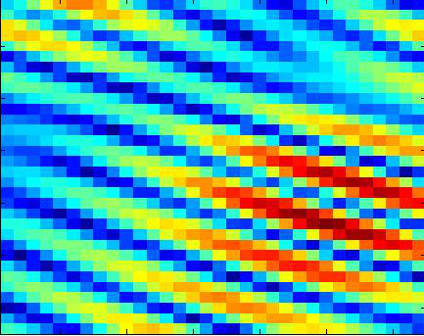
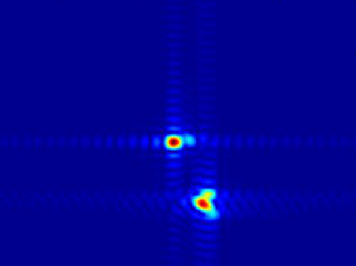
Beamspace channel
Spatial channel
Beamspace channel
Notes:
In this slide, we give some figures to explain beamspace MIMO more clearly. The figure in the top left corner is the prototype of beamspace MIMO built by Nokia. The figure in the top right corner shows the concentrating function of lens. The figure in the bottom left corner is the power distribution of the traditional spatial channel, while the last figure is the one of the beamspace channel. Obviously, with the help of lens antenna array, the beamspace channel becomes sparse.

Slide 7
Existing problem
Beam selection
Beamspace channel estimation
  Beam selection requires the information of beamspace channel
  Channel dimension is large while the number of RF chains is limited
  We cannot sample the signals on all antennas simultaneously
  Unaffordable pilot overhead
  Different hardware architecture compared to hybrid precoding
  Existing channel estimation schemes for hybrid precoding cannot be used
How to estimate the beamspace channel with low pilot overhead ?
Notes:
Nevertheless, although beamspace MIMO can reduce the number of RF chains via beam selection as shown in this figure, we still need to acquire the information of beamspace channel of large size. This is a challenging task, since the number of RF chains is limited, which means that we cannot sample the signals on all antennas simultaneously and the pilot overhead will be unaffordable. Moreover, as the hardware architecture are quite different with hybrid precoding architecture, most of the existing channel estimation schemes designed for hybrid precoding cannot be used. Above all, we need to design a new beamspace channel scheme with low pilot overhead.

Slide 8
Contents
1
Technical Background
2
Proposed Solution
3
Performance Analysis
4
Simulation Results
5
Conclusions
Notes:
To achieve the goal, in this paper, we propose a support detection based beamspace channel estimation scheme, which will be introduced in detail next.

Slide 9
Channel estimation in TDD model
Channel measurements
  All K users transmit orthogonal pilot sequences to BS over Q instants
  Q instants are divided into M blocks ( ), during the mth block
  BS combines the received pilot signals by
  Consider user k, after M blocks, we have the channel measurements as
  If we use traditional selecting network to design the combiner
  Each row of will have one and only one nonzero element
  If contains complete information of → → high pilot overhead
pilot :
Notes:
We first review the procedure of channel estimation in TDD model. In summary, all the users need to transmit mutual orthogonal pilot sequences to base station overhead Q instants, as shown in the first equation. Here we assume Q can be divided into M blocks. During the mth block, the base station employs a combiner W to combine the received pilot signals like the second equation. If we only focus on the user k, then the channel measurements can be presented by this equation. It is worth pointing out that if we use traditional selecting network to design the combiner, each row of W will have one and only one nonzero element. This means that when Q is larger than N, the measurement vector z_k_bar cannot contain the complete information of the channel. In this case, the pilot overhead will be unaffordable.

Slide 10
Adaptive selecting network
Adaptive selecting network
  Utilize analog phase shifter (PS) network to design
  , still contains complete channel information
  Sparse signal recovery problem
  In CS theory, the mutual coherence of should be as small as possible
  Bernoulli random matrix → 1-bit PSs→ low energy consumption
  Adaptivity
  For data transmission, turn off some PSs to realize beam selection
  For channel estimation, realize combiner to obtain channel measurements
Notes:
To this end, we propose an adaptive selecting network for beamspace MIMO systems. Its key idea is to replace the traditional selecting network by a phase shifter network as shown in this figure. During the data transmission, we can turn off some phase shifters to realize beam selection, while during the beamspace channel estimation, we can realize the combiner to obtain more efficient channel measurements. Under this new architecture, when Q < N, we can still guarantee that z_k_bar contains complete channel information, and the pilot overhead can be significantly reduced. Moreover, as the channel h_k is a sparse vector, the beamspace channel estimation problem in the previous slide can be formulated as a typical sparse signal recovery problem. Under the compressive sensing framework, our next task is to design the combiner using the proposed adaptive selecting network. In CS theory, the mutual coherence of W should be as small as possible. Therefore, in our paper, we adopt the Bernoulli random matrix, which can be realized by 1-bit phase shifters. This means that the cost and energy consumption of the adaptive selecting network is quite low.

Slide 11

Structural property of beamspace channel 1
Classical CS algorithms
  Deteriorated performance in low SNR region
  Low transmit power at user side
  Serious path loss of mmWave signals
  Lack of beamforming gain
Low SNR
We should utilize the structural properties of beamspace channel
Lemma 1. Present as , where is the ith channel component of in the beamspace. Then, when the number of BS antennas N goes infinity, any two channel components and are orthogonal, i.e.,
Insights
  The total estimation problem can be decomposed into a series of independent sub-problems
  Each sub-problem only considers one channel component
Notes:
After the combiner has been designed, we can use the classical CS algorithms, such as OMP to solve this problem. However, when the SNR is low, the performance of classical algorithms is deteriorated. Unfortunately, low SNR is a typical case for channel estimation in mmWave communications, since transmit power of user is low and the beamforming gain to overcome serious path loss is lacked. To achieve satisfying performance in the low SNR region, we need to utilize the structural properties of beamspace channel. The first property is proved in Lemma 1. It shows that when the number of antennas goes infinity, the beamspace channel can be presented as the summation of several mutual orthogonal channel components. This means that the total estimation problem can be decomposed into a series of independent sub-problems, each of which only considers one channel component.

Slide 12
Structural property of beamspace channel 2
Lemma 2. Consider the ith channel component in the beamspace, and assume V is an even integer. Then, the ratio between the power of V strongest elements of and the total power of can be lower-bounded by
Moreover, once the position of the strongest element of is determined, the other V-1 strongest elements will uniformly located around
Insights
  can be considered as a sparse vector with sparsity V
  The support of can be uniquely determined by
Notes:
The second structural property is proved in Lemma 2. It shows that the ratio between the power of the V strongest elements of the channel component c_i_wave and the total power of c_i_wave can be lower bounded by this equation. And once the strongest element is determined, the other V-1 elements will uniformly locate around it as shown in this figure. This means that c_i_wave can be well-approximated as a sparse vector with the sparsity V. And the support of c_i_wave is uniquely determined by the position of the strongest element.

Slide 13
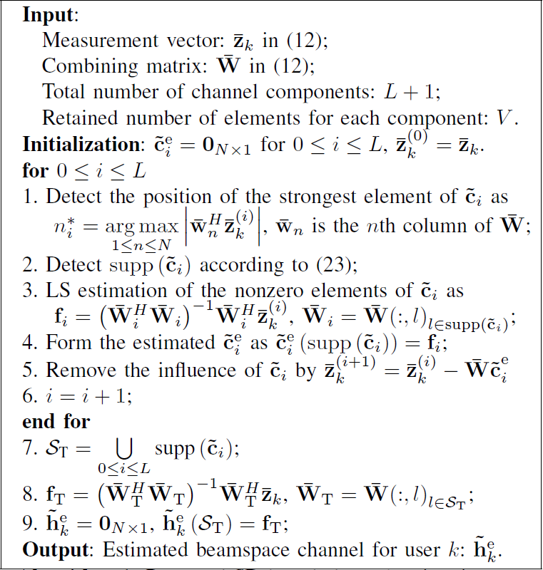
Support detection (SD) based beamspace channel estimation
Notes:
Based on the two structural properties of beamspace channel, we propose a support detection based beamspace channel estimation scheme, where the pseudo-code is provided in the left hand and the illustration figure is provided in the right hand. Here, we explain some key steps. During the ith iteration, in step 1, we first detect the position of the strongest element of each channel component by this equation. Then, in step 2, we can directly obtain the support. After the ith channel component has been estimated, we remove its influence for next iteration in step 5. Finally, after the supports of all components have been detected, we can obtain the total support of beamspace channel in step 7.

Slide 14
Contents
1
Technical Background
2
Proposed Solution
3
Performance Analysis
4
Simulation Results
5
Conclusions
Notes:
Next, we analysis the performance of our scheme.

Slide 15
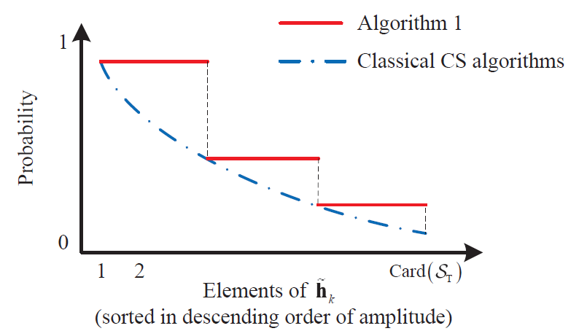
Performance analysis
Lemma 3. Consider the LoS scenario, i.e., and suppose that the strongest element of satisfies
where is a constant, and we define that
Then, the probability that the position of the strongest element is correctly estimated is lower-bounded by
Lemma 3 can be directly extended to the scenario with NLoS components
Insights
  For small , should also be small
  The probability decreases
Our scheme enjoys high accuracy than classical CS algorithms !
Notes:
（可不讲）In lemma 3, we prove the lower-bound of the probability that the position of the strongest element is correctly estimated. It shows that when the power of nonzero element is small, the probability for correct estimation will decrease. In classical CS algorithms, all the positions of nonzero elements are estimated in an iterative procedure, which may be inaccurate, especially for the element whose power is not strong enough. By contrast, in our algorithm, we only estimate the position of the strongest element, and directly obtain the accurate support with higher probability as illustrated in this figure.

Slide 16
Contents
1
Technical Background
2
Proposed Solution
3
Performance Analysis
4
Simulation Results
5
Conclusions
Notes:
Next, we provide simulation results to verify the performance of our scheme.

Slide 17
Simulation parameters
System parameters
  MIMO configuration:
  Total time slots: ( )
  Beam selection: Interference-aware (IA) beam selection [Gao’16]
  Dimension-reduced digital precoder: Zero forcing (ZF)
Channel parameters
  Channel model: Saleh-Valenzuela model
  Antenna array: ULA at BS, with antenna spacing
  Multiple paths: One LoS component and two NLoS components
  LoS component
  Amplitude: Spatial direction:
  NLoS components
  Amplitude: Spatial direction:
[Gao’16] X. Gao, L. Dai, et al., “Near-optimal beam selection for beamspace mmWave massive,” IEEE Commun. Lett., 2016.
Notes:
The simulation parameters are set as follows. The BS employs a lens antenna array with 256 elements to serve 16 users. The number of RF chains is also set as 16. The instants for pilot transmission is 96. After the beamspace channel has been estimated, we use interference-aware beam selection and zero forcing precoding for data transmission. The channel is generated following the Saleh-Valenzuela multipath model, where we assume one LoS path and two NLoS paths.

Slide 18
Simulation results
Observations
  SD-based channel estimation outperforms conventional schemes
  The performance is satisfying even in the low SNR region
  The pilot overhead is low, i.e.,
The proposed scheme can accurately estimate the beamspace channel with low pilot overhead, even with low SNR!
[Gao’16] X. Gao, L. Dai, et al., “Near-optimal beam selection for beamspace mmWave massive,” IEEE Commun. Lett., 2016.
Notes:
The figure in the left hand shows the MSE performance comparison, where the blue line is the conventional OMP channel estimation and red line is our scheme. We can observe that our scheme performs better, specially in the low SNR region. The figure in the right hand shows the sum-rate performance of beam selection with different channels, where green line is OMP and red line is our scheme. We can see that our scheme can accurately estimate the beamspace channel. Finally, it is worth pointing out that by using the idea of compressive sensing, the pilot overhead of our scheme is also low.

Slide 19
Contents
1
Technical Background
2
Proposed Solution
3
Performance Analysis
4
Simulation Results
5
Conclusions
Notes:
Finally, we make a brief summary of our paper.

Slide 20
Summary
SD-based beamspace channel estimation
  We design an adaptive selecting network to construct the beamspace channel estimation problem as a typical sparse signal recovery problem
  We propose to decompose the total estimation problem into a series of sub-problems, each of which only considers one sparse channel component
  We propose to utilize the structural properties of beamspace channel to accurately detect the support of each sparse channel component
Advantages
  Our scheme enjoys satisfying accuracy, even in the low SNR region
  Our scheme involves quite low pilot overhead
  With our scheme, beam selection can achieve the near-optimal sum-rate
Notes:
The contributions of this paper can be summarized as follows: firstly, we…; secondly, we…; finally, we…. It is shown that our scheme can achieve satisfying accuracy with low pilot overhead, even in the low SNR region. Moreover, with our scheme, beam selection can achieve the near-optimal sum-rate performance with much lower energy consumption.

Slide 21

Thanks
Simulation codes for most papers are provided for reproducible research !
http://oa.ee.tsinghua.edu.cn/dailinglong/

